Slide 1

Ballte of The Boroughs
IBM DATA SCIENCE CAPSTONE Project by Malte Jörg

Slide 2
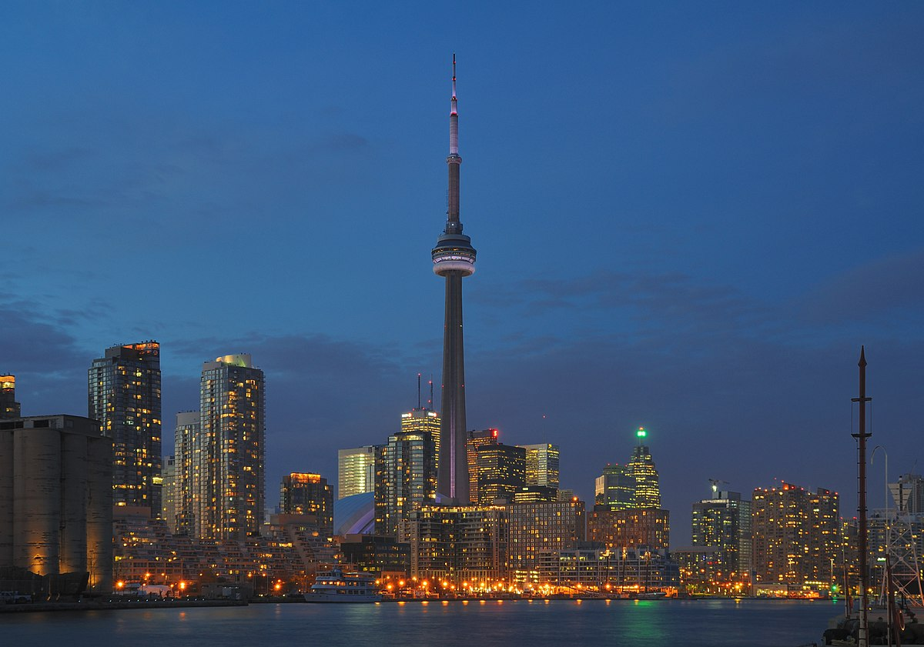
introduction
Analysis and comparison of major boroughs
Toronto
Canda‘s largest city
World leader in areas as bussiness, finance, technology, …
Large population of immigrants
New York
Largest city in the U.S.
Financial powerhouse
Numerous museums, parks and neighborhoods

Slide 3
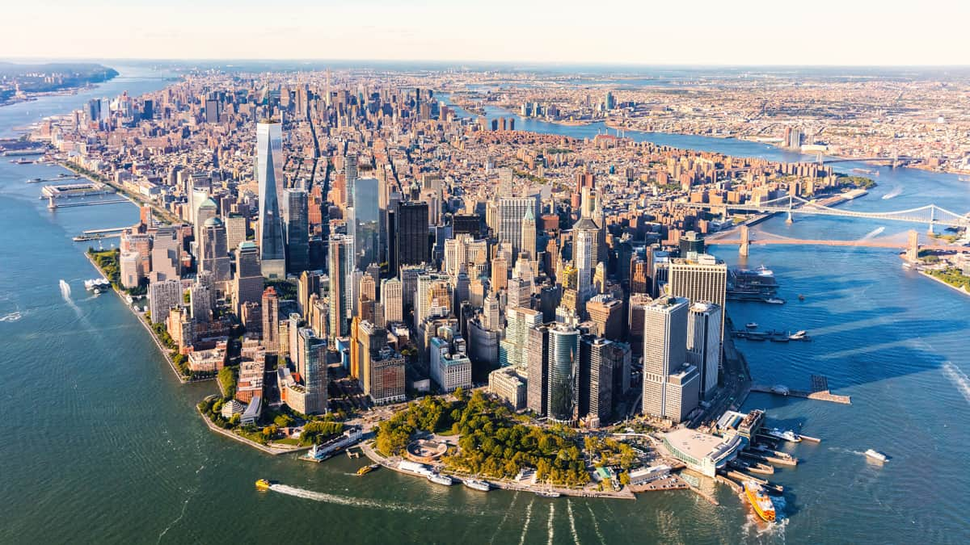
Introduction
Both cities located in western North America
Venues are used to describe differences
Cultural aspects
Livability of a city
Goal:
Select the two major boroughs of both cities
Analyze and compare both boroughs with their venue data
Determine cultural differences
Help for tourists with gained insights of the cities

Slide 4
Data description
Location Data
Provided by Coursera
Scraped via wikipedia page
Borough, Neighborhood, Location data as features
Venue Data
Gathered via the Foursquare API
Name of venue, venue category and venue location as features
Venue Category Data
From Foursquare
Provides a list of venue categories and sub-categories

Slide 5
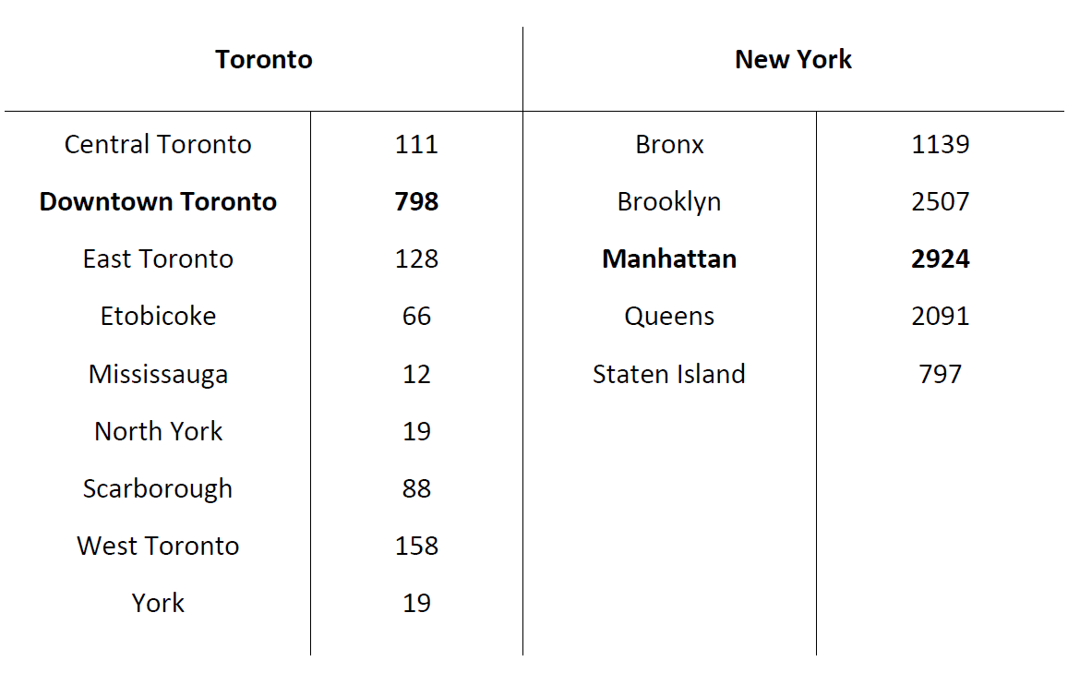
Data Examination
Boroughs of the two cities
Toronto 9
New York 5
Table shows amount of venues in each borough
Select borough by maximum amount
Downtown Toronto
Manhattan

Slide 6
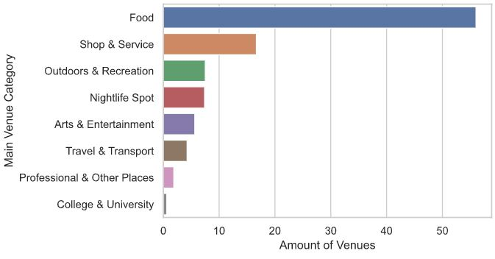
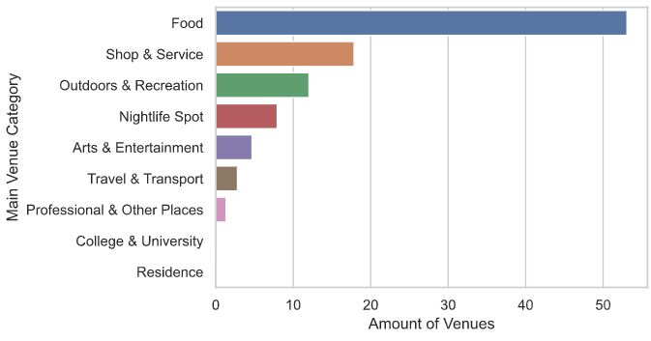
Data Examination
Relative amount of venues in boroughs
Downtown Toronto
Manhattan

Slide 7
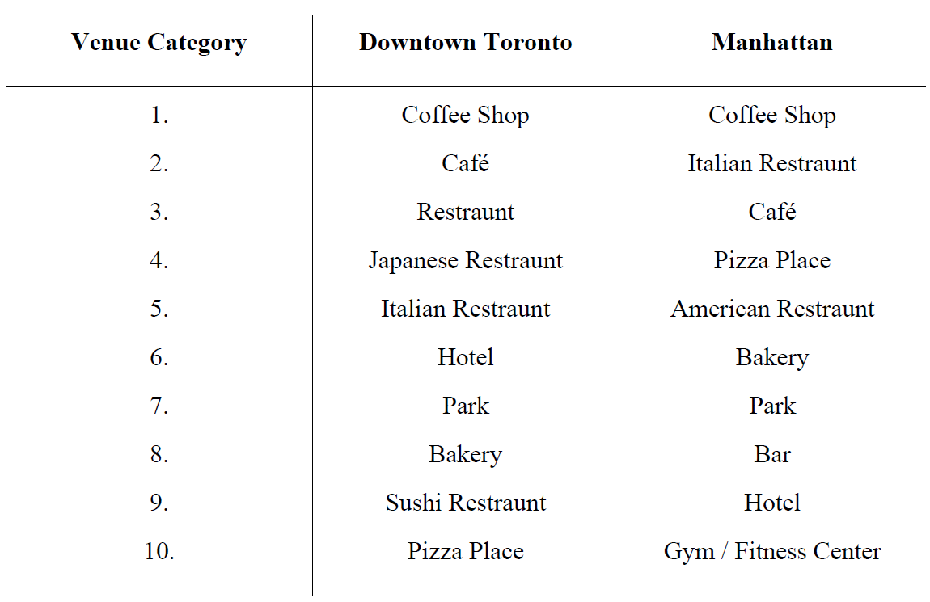
Data Examination
Top 10 venue categories
Coffee Shop is top category
Downtown Toronto with more asian food places
Manhattan more american and italian

Slide 8
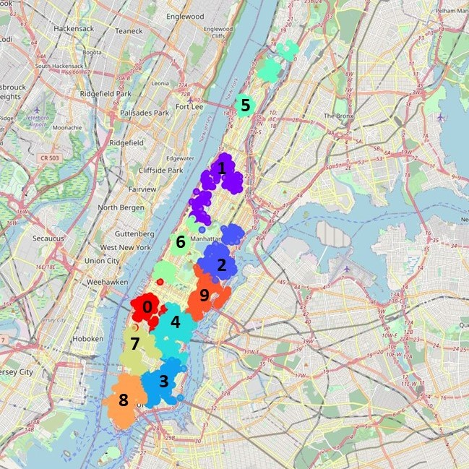
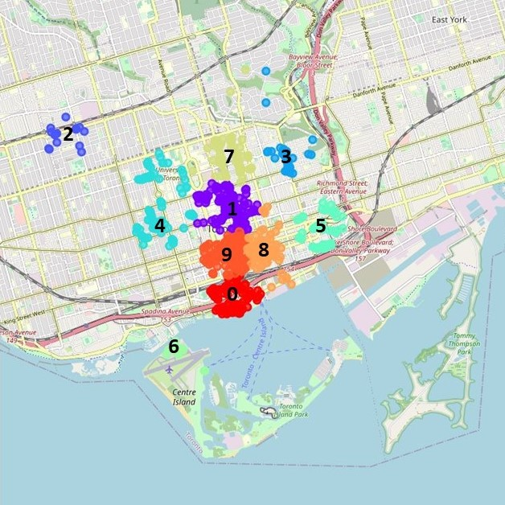
Modeling
Clustering of the two major boroughs
kMeans clustering with 10 clusters
Feature: Geographical Location
Clusters are numbered from 0 - 9
Downtown Toronto
Manhattan

Slide 9
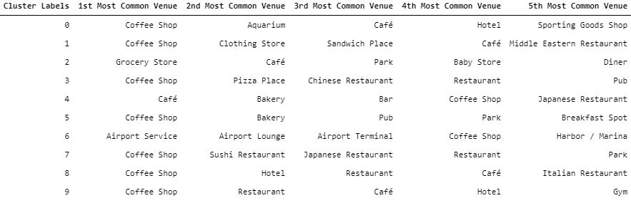
Results
Downtown Toronto
Most common venues in each cluster

Slide 10
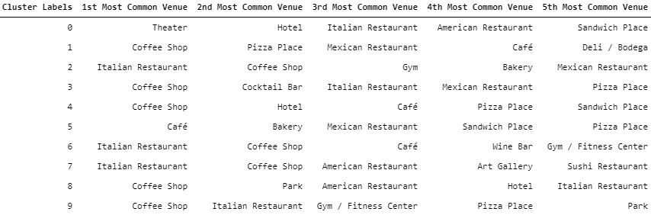
Results
Manhattan
Most common venues in each cluster

Slide 11
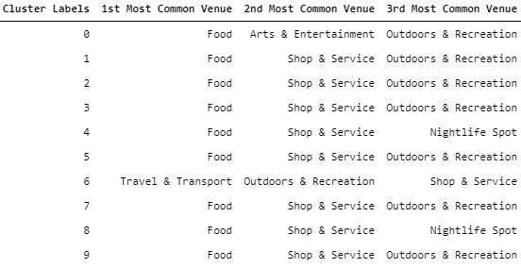
Results
Downtown Toronto
Most common main venue category

Slide 12
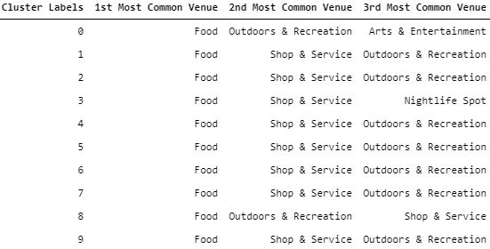
Results
Manhattan
Most common main venue category

Slide 13
Discussion
Data gives a good outlook on the cities culture
Some surprising findings in data
Chinatown in Manhattan New York
More italian places than expected
Food and Coffee are superior venue categories
More insights with more diverse venues like businesses
Manhattan more livable
Downtown Toronto more for businesses and tourists

Slide 14
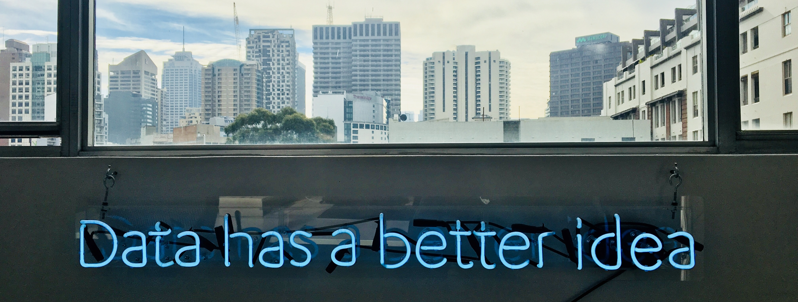
Thank YOU FOR YOUR ATTENTION

